Slide 1
INSULINS

Slide 2
Classification of Diabetes
Type 1 Diabetes
Type 11 Diabetes
Diabetes due to secondary causes
Gestational Diabetes

Slide 3
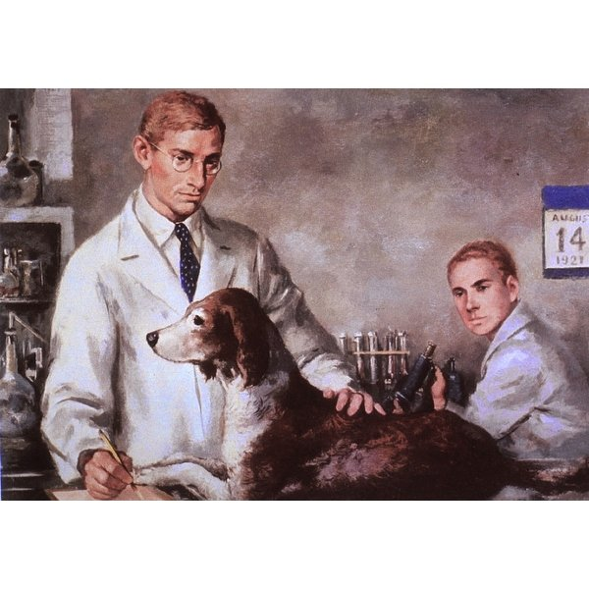

Slide 4
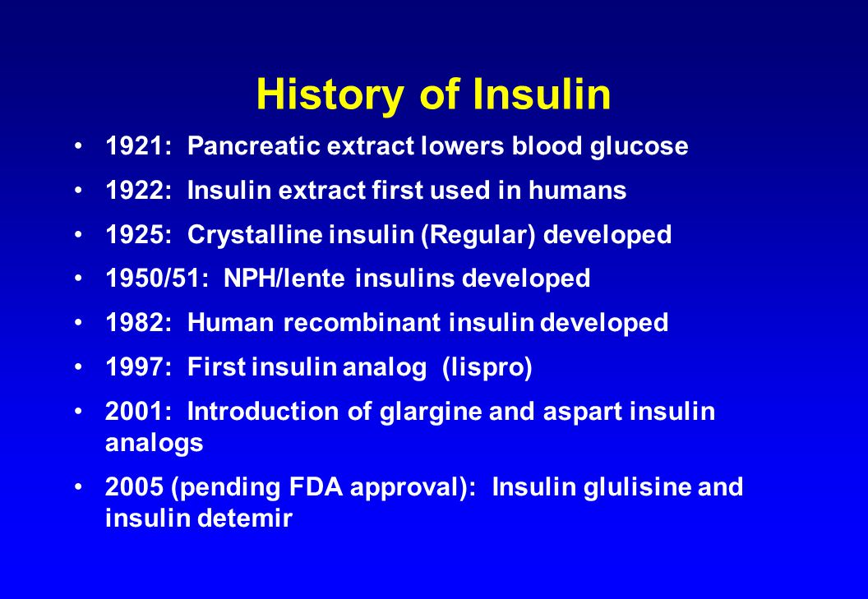

Slide 5
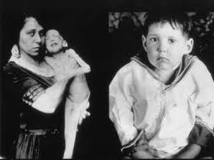

Slide 6
Insulin
Polypeptide with 2 peptide chains
Linked by 2 disulphide Bonds
Metabolic activity is common to all mammalian species
Daily secretion 30-40 units

Slide 7
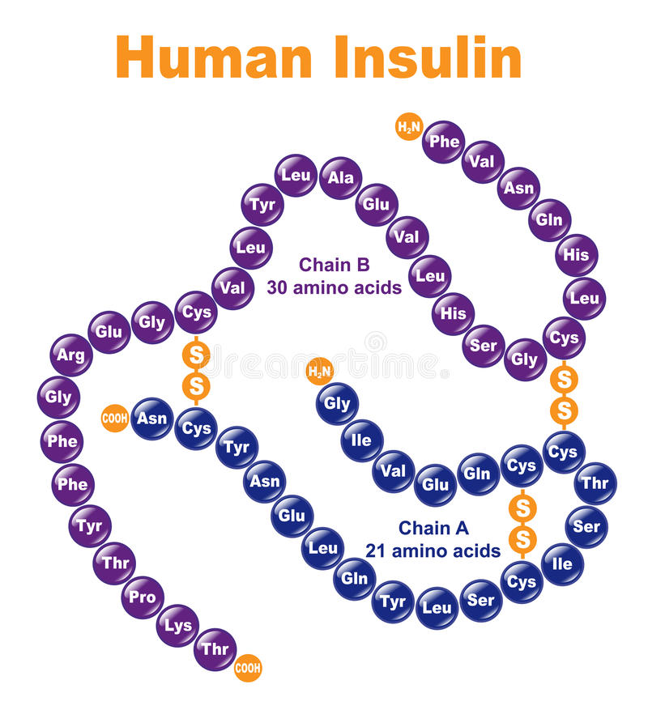

Slide 8
Pharmacokinetics
Injected because digested if swallowed
Absorbed in to the blood inactivated in the liver and kidney.
10% appear in urine (Clinically significant).
T 1/2 is 5 min
Peak plasma concentration is in 30-90 min

Slide 9
Sources of Insulin
Bovine Insulin- Differs by 3 amino acids
Porcine Insulin- By 1 amino acid
Human Insulin
  Enzyme Modification of porcine Insulin
  Recombinant DNA technology

Slide 10
Insulin analogues
Modified insulins to alter its absorption characteristics
  Insulin lispro
  Insulin aspart
  Insulin glargine
  Insulin detemir

Slide 11
Preparations of Insulins.
Source of Insulin(Human, Bovine, Porcine)
Formulations
  Short acting
  Intermediate acting
  Long acting

Slide 12
Short Duration of action Insulins
Rapid onset of action
  Soluble Insulin
  Insulin Lispro
  Insulin Aspart

Slide 13
Intemediate duration of action & long acting insulins
NPH insulin (Neutral Protamine Hagedorn) insulin-Isophane Insulin - A suspension with protamine
Insulin glargine (Lantus insulin)
Insulin detemir (Levamir insulin)

Slide 14
Insulin mixtures
Mixture of soluble insulin and Isophane insulin
Most commonly used ones are human Insulins
Soluble Insulin at 10-50% of total Insulin concentration
Remove the need for patients to mix Insulin

Slide 15
Indications for use of Insulin.
Type 1 Diabetes mellitus
Type 11 Diabetes
  Diabetic ketoacidosis
  Non ketotic hyper osmolar coma
  Surgery
  Infections
  MI
Pregnancy

Slide 16
Side effects of Insulin
Hypoglycaemia
  Warning signs due to Neuroglycopenia
  Coma ,Convulsions and Death
Allergic reactions
Lipoatrophy
Lipohypertrophy

Slide 17
Soluble Insulin
Short duration of action
Used 30m before meals
3 times a day
Colourless.
Is given I.V in diabetic ketoacidosis.

Slide 18
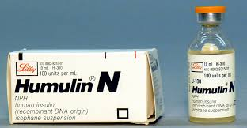

Slide 19
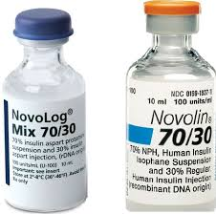

Slide 20
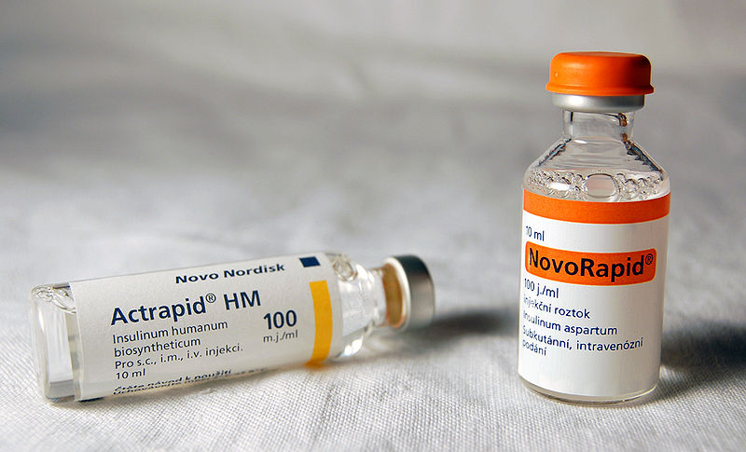

Slide 21
Dose of Insulins
100u/ml
Total daily output is 30-40 units a day
Daily increment is 4 units a day.
A dose of over 100u/day is due to noncompliance.

Slide 22
Insulin devices
Pens
Pumps

Slide 23
Advice to the patient
Don’t skip a meal
Regular quantities of meals
Signs of hypoglycaemia
Card
Sweet
Be aware of the quality of insulin
  Storage
  Transport
  Quality of insulin

Slide 24
Insulin + OHG
When to use
Advantages

Slide 25
Glucagon
Main clinical use is IM in patients who are unconcious at home who cannot have IV access or oral glucose

Slide 26
Mointoring
FBS
PPBS
Hb A1c
Fructosamine
Blood sugar series

Slide 27
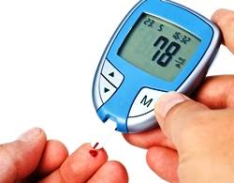

Slide 28
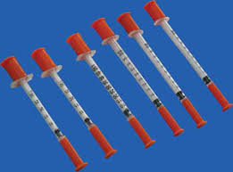

Slide 29


Slide 30
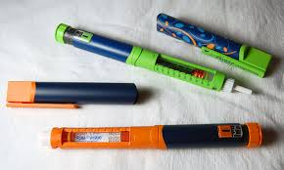

Slide 31


Slide 32
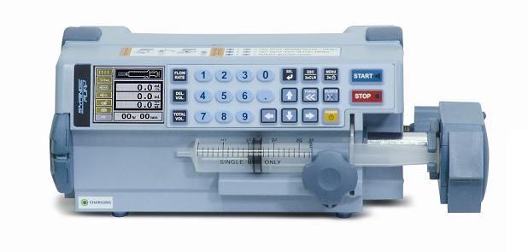

Slide 33
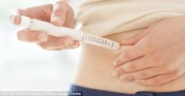

Slide 34
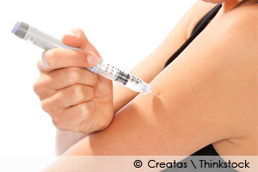

Slide 35
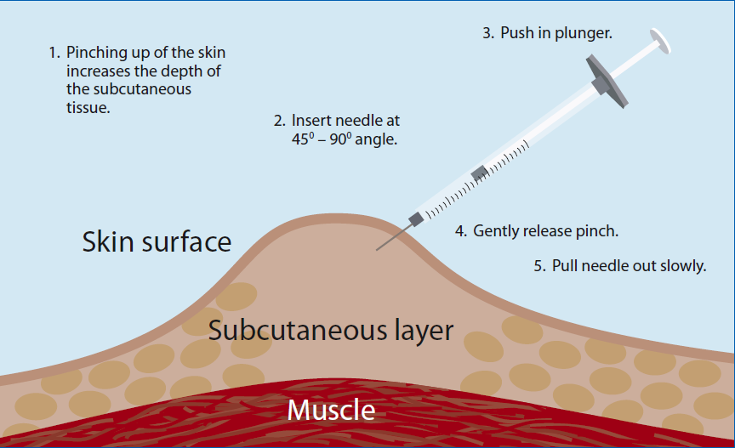

Slide 36
Management of complications
Hypercholesterolaemia/Hyperlipdaemia
  Statins/Fibrates
Hypertension
  ACEI/ARB/Calcium channel blockers
Microalbumin uria/ Nephropathy
  ACEI/ARB

Slide 37
Diabetic emergencies
Diagnosis
DKA
Non ketotic hyperosmolar coma
Hypogycaemic coma

Slide 38
DKA
Correct hydration
Insulin replacement
Correct acid base abnormalities and electrolyte abnormality if indicated

Slide 39
Non ketotic hypeosmolarcoma
Hydration
Insulin IV

Slide 40
Hypoglycaemic coma
Diagnosis
Sweets
IV dextrose
IM glucagon

Slide 41
Diabetes in pregnancy
Gestational DM/Pre existing diabetes
Insulin
Metformin
Needs good control

Slide 42
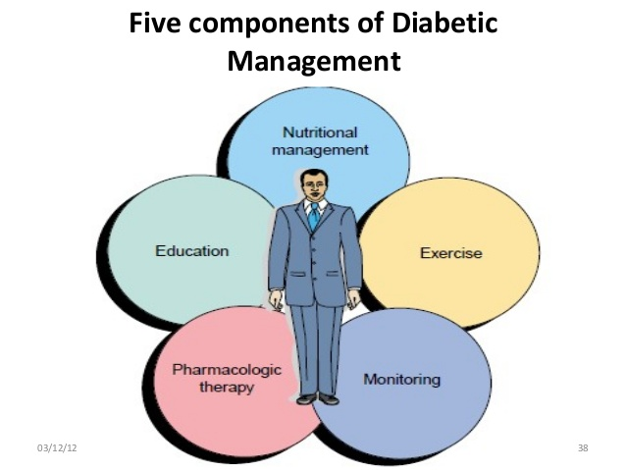

Slide 43
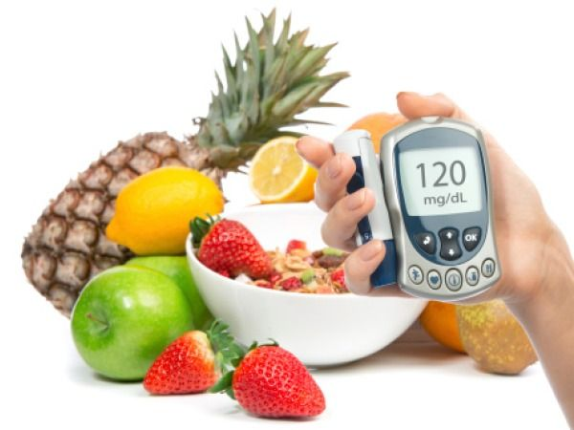

Slide 44
